Slide 1
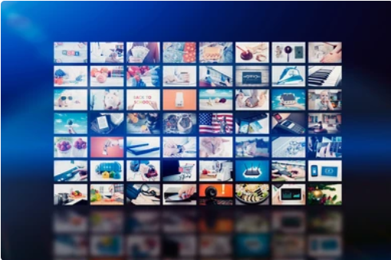
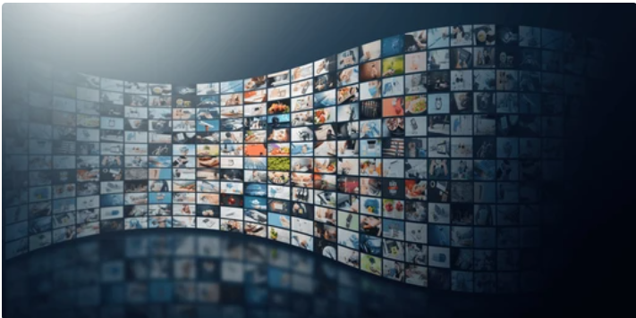

Video in Multimedia
Introduction
Video is a key component of multimedia that integrates moving images with sound.
Used in various fields like entertainment, education, marketing, and communication.
Formats: MP4, AVI, MOV.

Slide 2
Importance of Video in Multimedia
Enhances engagement and retention:
People retain more information from videos compared to text or images alone.
Increases accessibility and reach:
Video can be shared widely across platforms, making information more accessible to diverse audiences.
Provides a dynamic and immersive experience:
Combines visuals, sound, and motion to create engaging content.
Useful for demonstrations, storytelling, and virtual experiences:
Ideal for tutorials, brand storytelling, and simulations.

Slide 3
Types of Video Content
Promotional Videos : Advertisements and product showcases designed to promote services or goods effectively.
Live Streaming: Real-time events, webinars, and Q&A sessions that allow for direct interaction with viewers.
Entertainment Videos: Short films, series, and vlogs that aim to entertain and engage the audience.
Informational Videos: : These include tutorials, how-to, and educational content that help viewers learn new skills.
Social Media Videos : Short clips tailored for platforms like Instagram, TikTok, and YouTube for maximum engagement.

Slide 4
Animation: Animated videos simplify complex ideas, often used in education.
Live-Action : Live-action videos engage viewers by showcasing real events.
Info graphics with Video : Combining info graphics and video enhances data visualization.
Interactive Video : Interactive videos allow viewer choices, enhancing engagement.
Screen Recording: Captures digital screen activities for tutorials and demonstrations.

Slide 5




